Slide 1

Face Recognition Based on Random Feature
Shasha Li & Weihong Deng
Beijing University of Posts and Telecommunications

Slide 2
1
Abstract
4
Experiments
CONTENT
2
3
Face Representation
Some Concepts

Slide 3
CHAPTER

Slide 4
Abstract
Describe face on three levels
pixel-level
region-level
image-level
Outstanding robustness against noise

Slide 5
CHAPTER

Slide 6
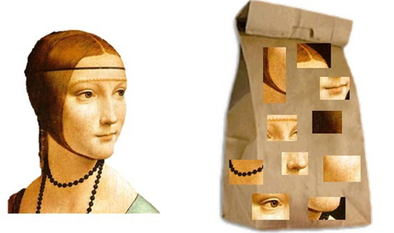
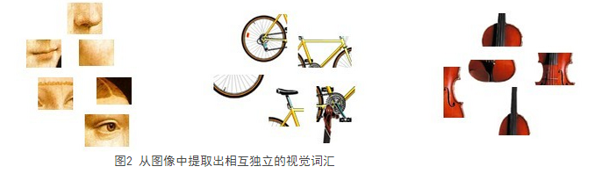
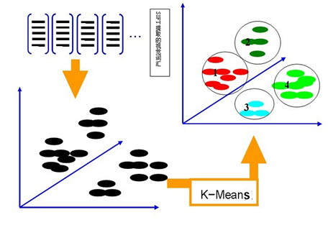
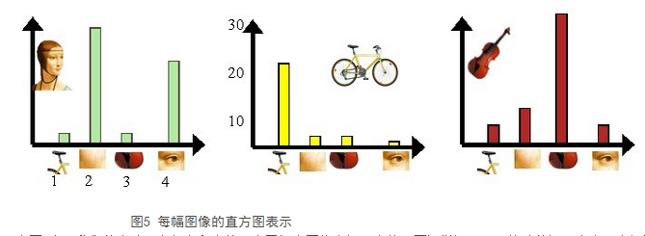
Concept 2-1 Bag-of-words model
1
2
3
4

Slide 7
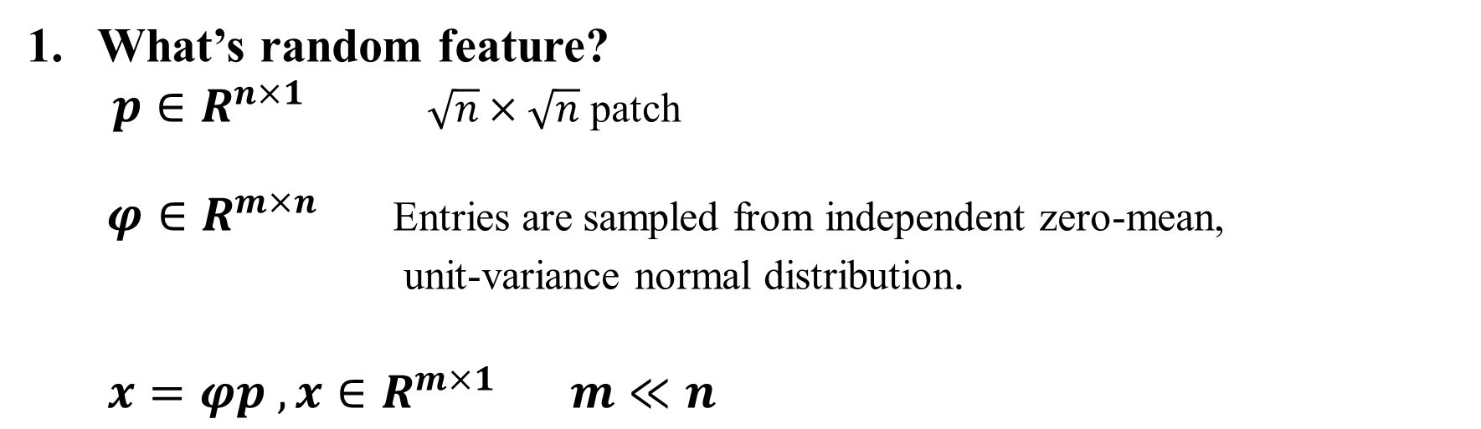
Concept 2-2 Random Feature
What’s random feature?
$p∈R^{n×1}$ $\sqrt{n}×\sqrt{n}$ patch
$φ∈R^{m×n}$ Entries are sampled from independent zero-mean, unit-variance normal distribution.
$x=φp ,x∈R^{m×1 } m≪n$

Slide 8
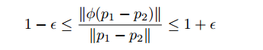
Concept 2-2 Random Feature
2. Why random feature?
Reduce feature dimensionality.
Preserve information

Slide 9
CHAPTER

Slide 10
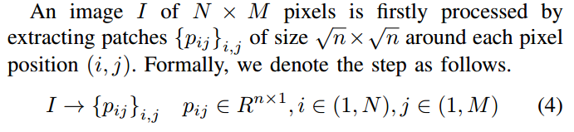
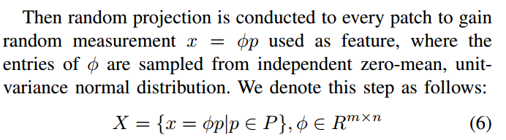
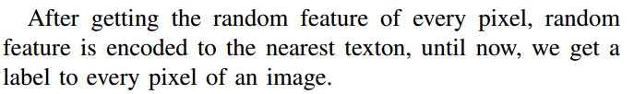
Face Representation
Step1: A label is assigned to every pixel of an image.

Slide 11
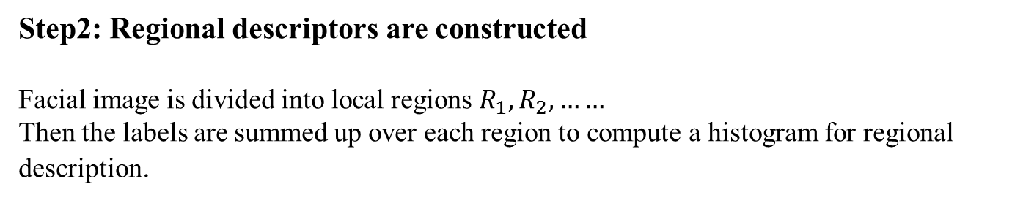
Face Representation
Step2: Regional descriptors are constructed
Facial image is divided into local regions $R_{1},R_{2},……$
Then the labels are summed up over each region to compute a histogram for regional description.
Step3: Global descriptor is constructed
All the regional histograms are concatenated to form the global histogram, which encodes both the appearance and the spatial relations of facial regions.

Slide 12
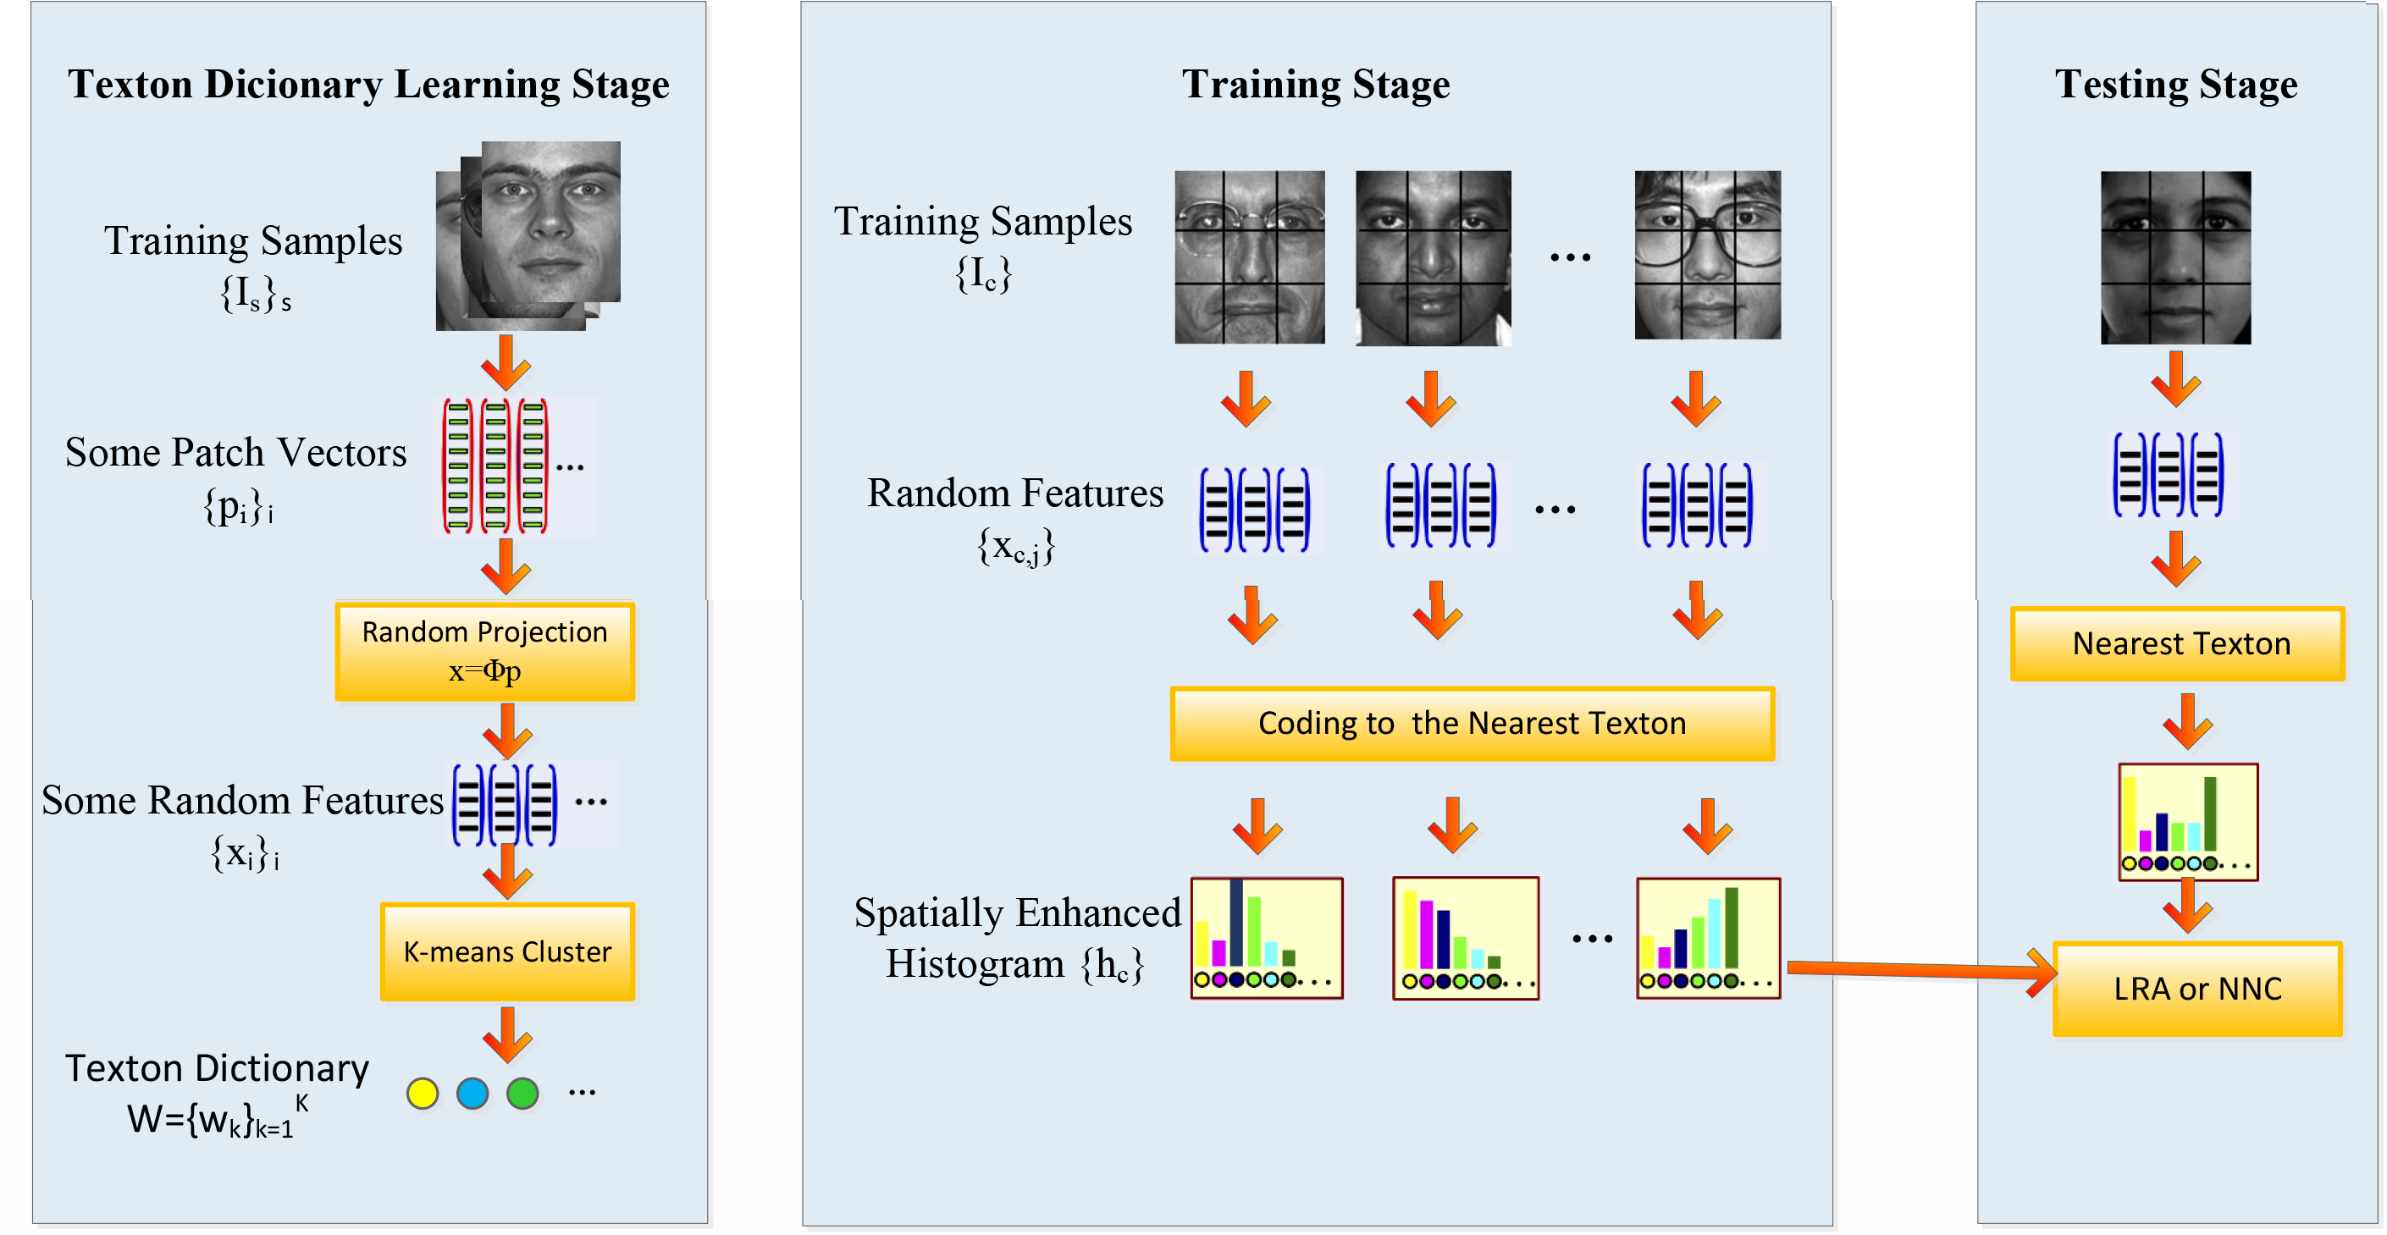
Face Representation
Recognition System Based on Random Feature

Slide 13
CHAPTER

Slide 14
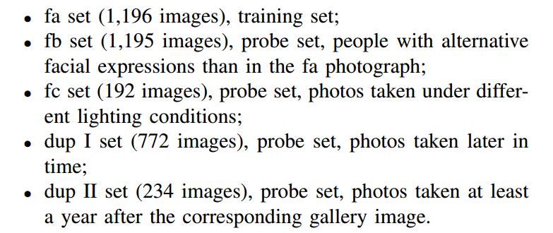
Experiments 4-1 Setup
FERET database:

Slide 15
Experiments 4-2 Parameters
There are some parameters that can be chosen to optimize the performance of the recognition system. These include:
the size of patch n,
the dimensionality of random feature m,
the number of textons K,
the division of the images.

Slide 16
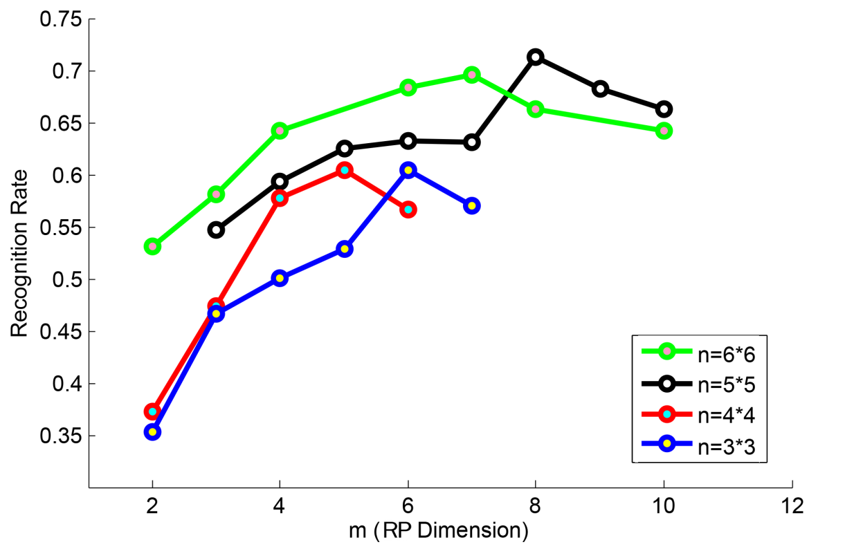
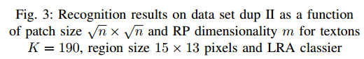
Experiments 4-2 Parameters
the size of patch n,
the dimensionality of random feature m,

Slide 17
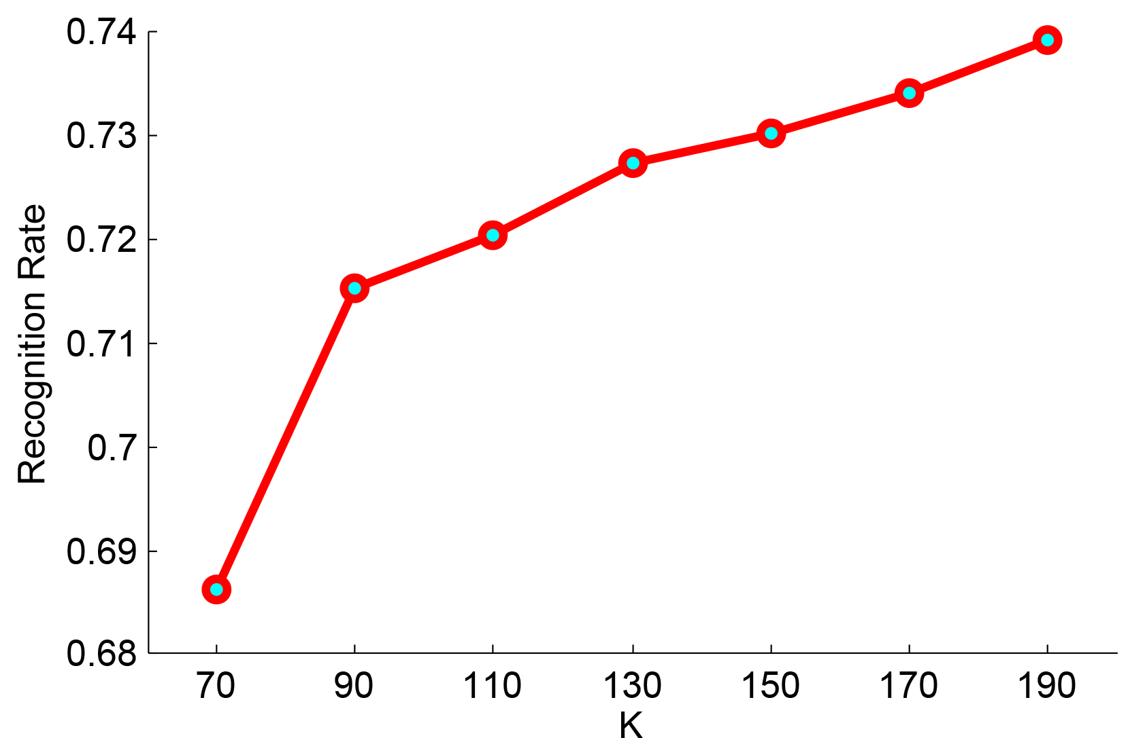
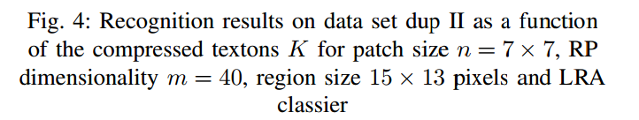
Experiments 4-2 Parameters
the number of textons K

Slide 18
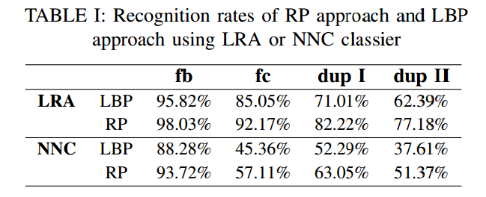
Experiments 4-3 Robustness
The proposed RP approach is compared with LBP.

Slide 19
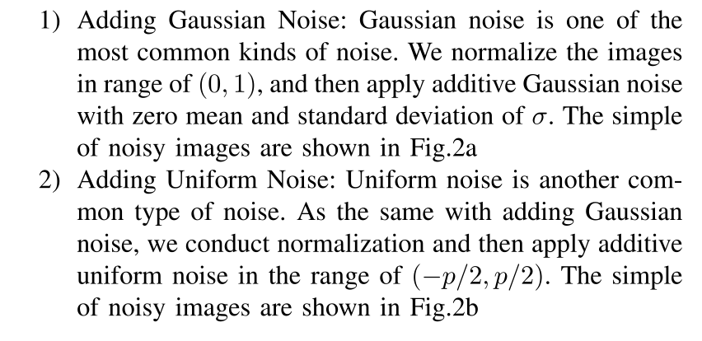
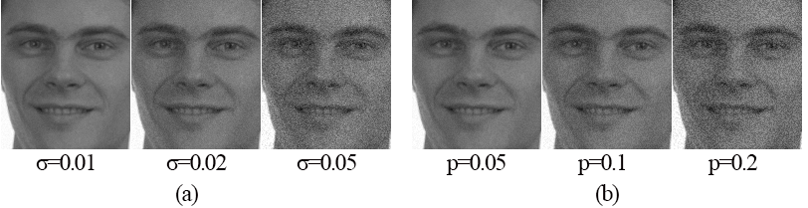
Experiments 4-4 Robustness against noise

Slide 20
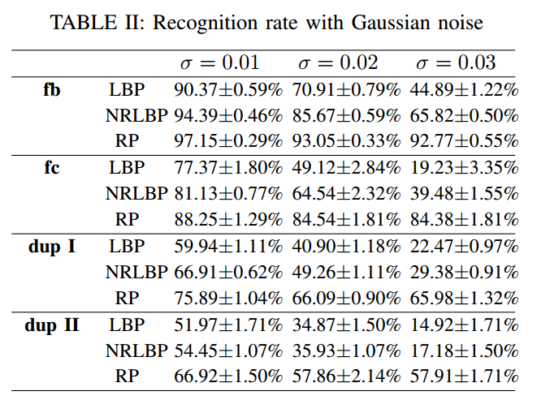
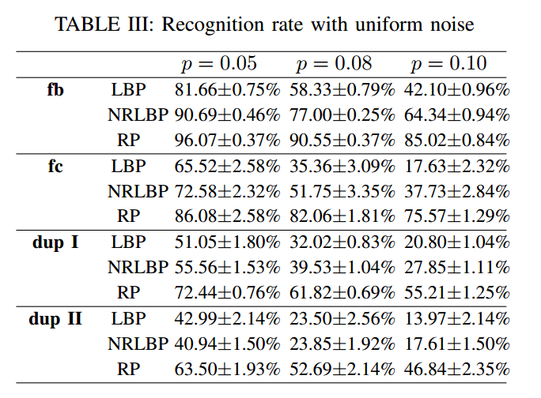
Experiments
The proposed RP approach is compared with LBP and NRLBP.

Slide 21
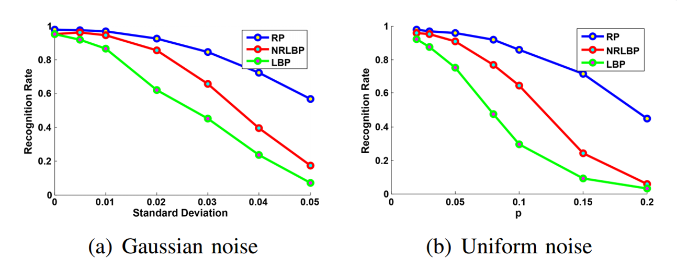
Experiments

